Slide 1
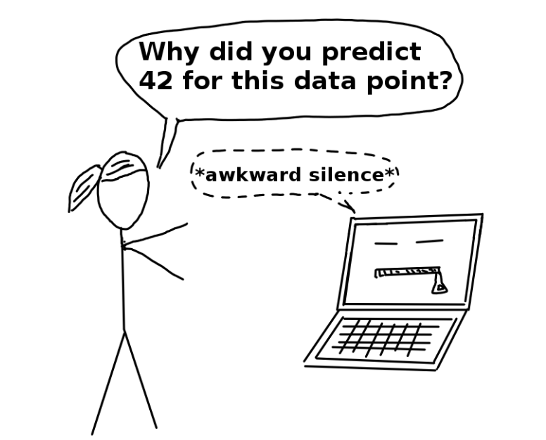
Transparency Product – Why?
If a machine learning model performs well, why do we not just trust the model and ignore why it made a certain decision?
1. Human curiosity and learning.
2. safety measures and testing: Self-driving car
earning models into racists that discriminate against underrepresented groups
3. increase social acceptance
4. Machine learning models can only be debugged and audited when they can be interpreted
1. Which variables is most important and how it contribute to the final prediction
2. Is any variables correlated with protected variables that lead to fairness concerns?
3. Why I get this credit score? How can I increase it?
4. How can I fine-tune the model to avoid overfit/under fit

Slide 2



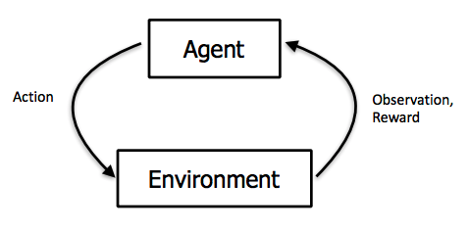
Machine Learning - Learning Approaches
Machine Learning is a process for computers to learn without being explicitly programmed.
Supervised Learning: Learning with a labeled training set
E.g.: Classification of risky and non–risky customer based on past data
Supervised learning
Unsupervised Learning: Discovering patterns in unlabelled data
Example: cluster similar customers based on demographics
Unsupervised learning
Reinforcement Learning: learning based on feedback or reward
Example: learn to play chess by winning or losing
Reinforcement Learning

Slide 3
Transparency Product
Developing a tool for integrating transparency best practices into the ML model development process as standard using a framework of Explainability tools and best practice guidelines
Capturing the source of data, collection/sampling process, exclusions, biases, etc. (`Datasheet for data`)
Tracebility
Process Implementation –Require new processes / best practices to be introduced in the AL / ML development cycle to align with FEAT principles
Global Explainability
Local Explainability
Feature Explainability
Model Explainability
Product Development –Require tools / products to be created that can facilitate quick and easy computation of transparency metrics
Explainability
Data Dictionary
Feature Importance
PDP / SHAP / Permutation Feat Imp.
Feature Interaction
Friedman’s H-Statistic
SHAP
ALE
Explain Prediction /
SHAP / ICE / Counterfactual / Reason Codes
Simulate scenarios
Surrogate Models AutoML Linear
Compare Records
Report model capability, design, working. Explain performance measures and guidelines for responsible use
Submodules required with recommended open-source tools to be used in the Explainability module
Reporting
Notes:
Process vs Product
Interpretability for Analytics Teams vs Business/Product Lead vs End Users vs CXO
Stages of development
Questions
Feature:
Relative Importance(Table); Direction(Feature vs Target Rate Line Chart)
Feature Interaction: Why 2 correlated features are present in model
Model
??
Prediction

Slide 4
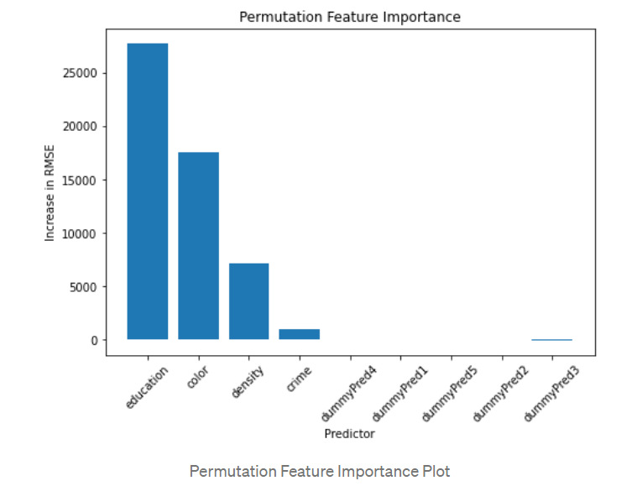
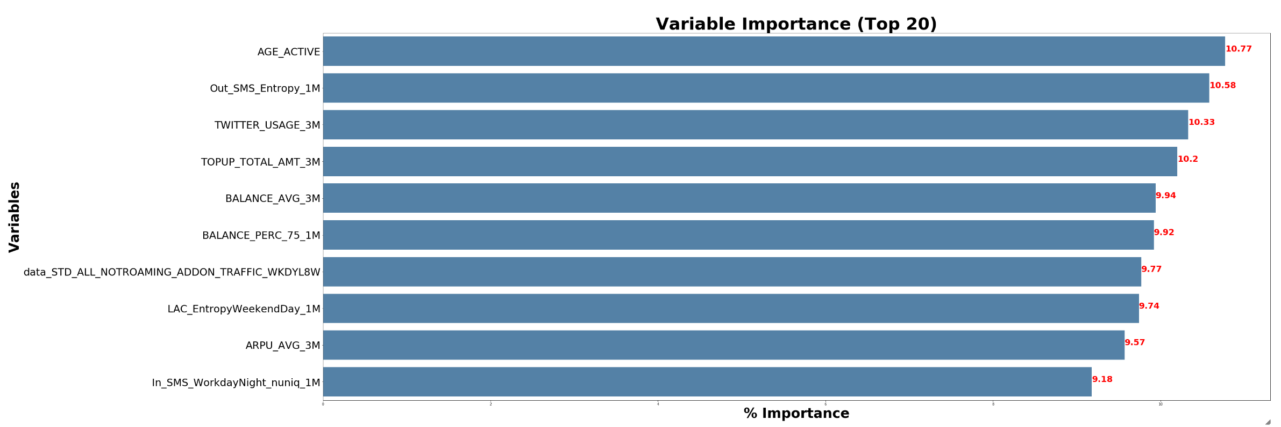
Transparency Product – Feature & Model Explainability
Step1 – General understand the model on variables importance
Here we recommend Permutation feature importance.
Permutation feature importance: measures the increase in the prediction error of the model after we permuted the feature’s values
.
Common questions to be answered:
What are the top features in this model?
What is the relative importance of feature X vs Y?
Permutation Importance:
Variables importance:

Slide 5
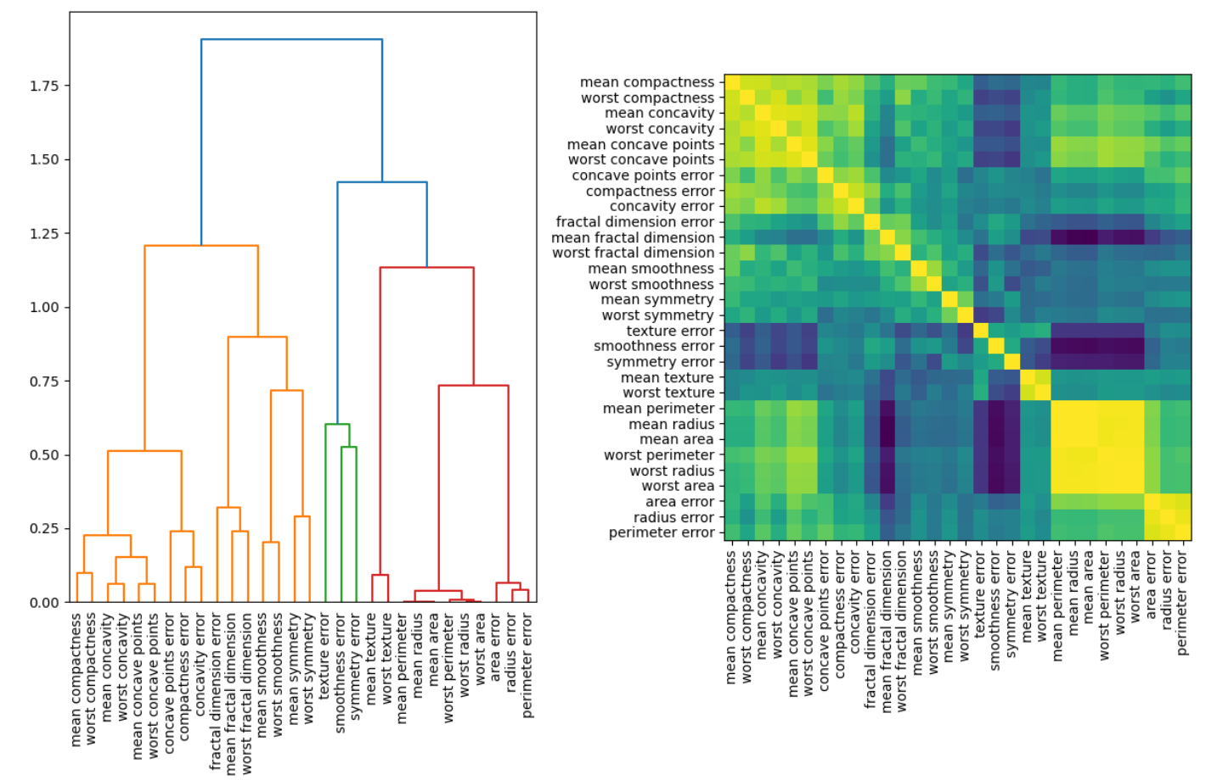
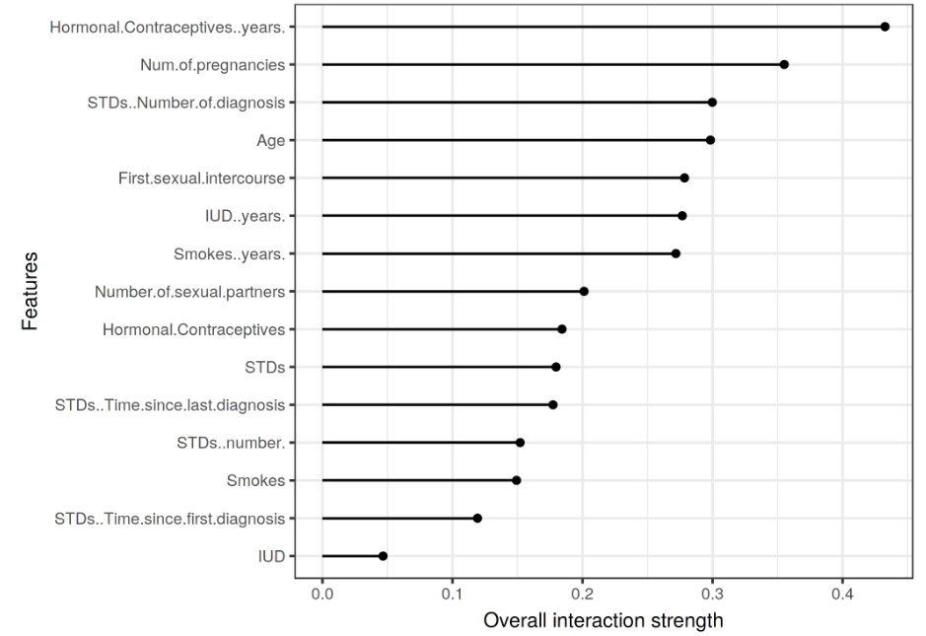
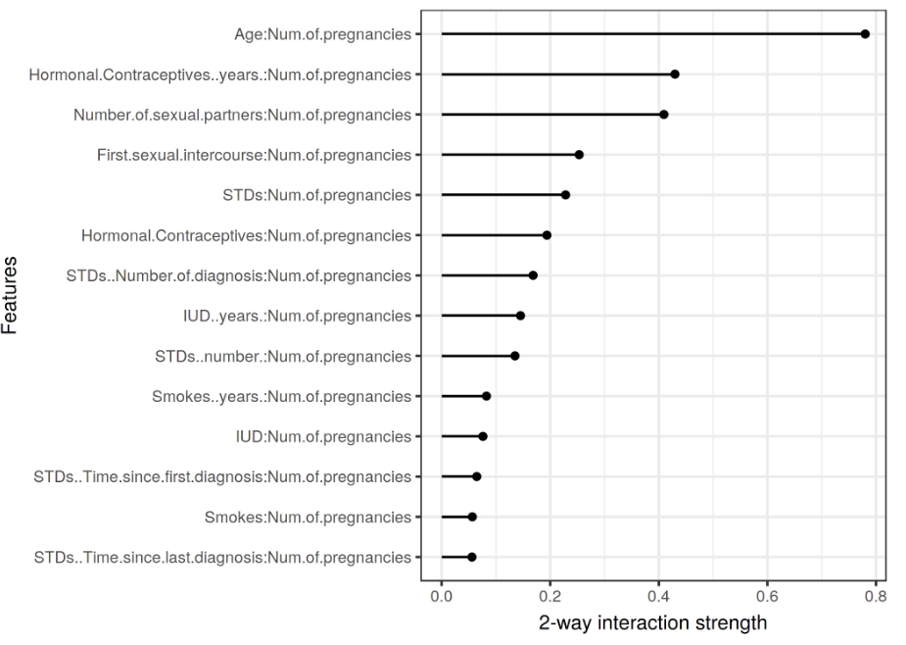
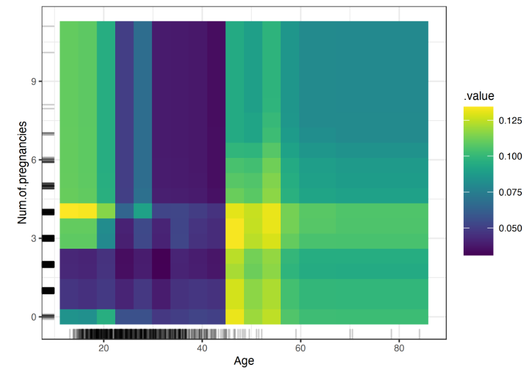
Transparency Product (WIP) – Feature & Model Explainability
Step2 – Variables effect
Step2.1 Understand variables interaction and its effect on final prediction
Here we propose 3 technique combined to evaluate:
Variables Cluster. Based on different cutoff of variables correlation, variables cluster into different group. This can give us a view on how variables correlated each other. Usually, correlation large than 0.5 will consider as a strong correlation.
Friedman’s H-statistic: Then for the high correlated variables, we can check the value of H-statistic on whether this correlation contribute a lot in the final prediction. If H-statistic is10%, then it means 10% of variance is explained by this feature interaction with other variables. There don’t have rule of thumbs for H-statistic, but general 10%-20% is relatively low and above 30% then we may should pay attention. (if high correlation but low h- …)
2D PDP plots. Show the combined effect of the correlated features. (Kindly notice if we are only interested in the interaction effect, we should look at the second-order effects on ALE 2D plots, because the PDP plots is focus on total effect which already mixes the main effects into the plot)
.
Variables Cluster:.
Friedman’s H-statistic
2D PDP plots:
Common questions to be answered:
Does that model contain two (or more) highly correlated both features?
Is the correlated variables interaction have a strong effect on the final prediction?
How will the correlated variables interaction contribute to the final prediction?

Slide 6
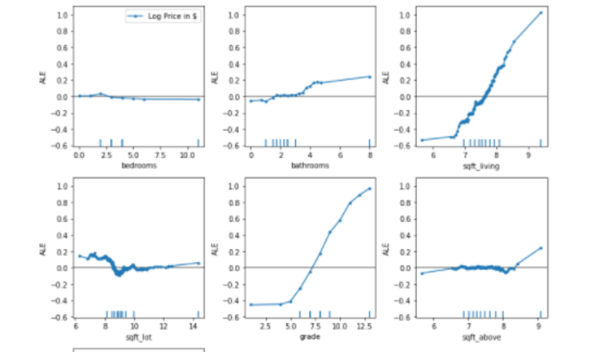
Transparency Product (WIP) – Feature & Model Explainability
Step2 – Variables effect
Step2.2 Understand how single variables correlated with target
The common technique is Partial Dependence Plot(PDP plot) and Accumulated local effects (ALE) plot. Here we recommend ALE over PDP. ALE describe how features influence the prediction of a machine learning model on average. It’s a faster and unbiased alternative to partial dependence plots (PDPs)
The value of the ALE can be interpreted as the main effect of the feature at a certain value compared to the average prediction of the data.
For example, an ALE estimate of -2 at xj=3xj=3 means that when the j-th feature has value 3, then the prediction is lower by 2 compared to the average prediction.
Accumulated Local Effects (ALE) – Feature Effects Global Interpretability
Common questions to be answered:
What is the relationship between feature X and target?

Slide 7
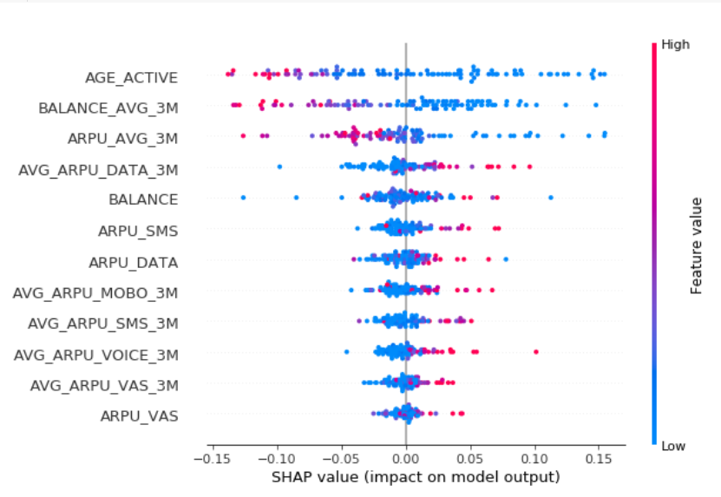
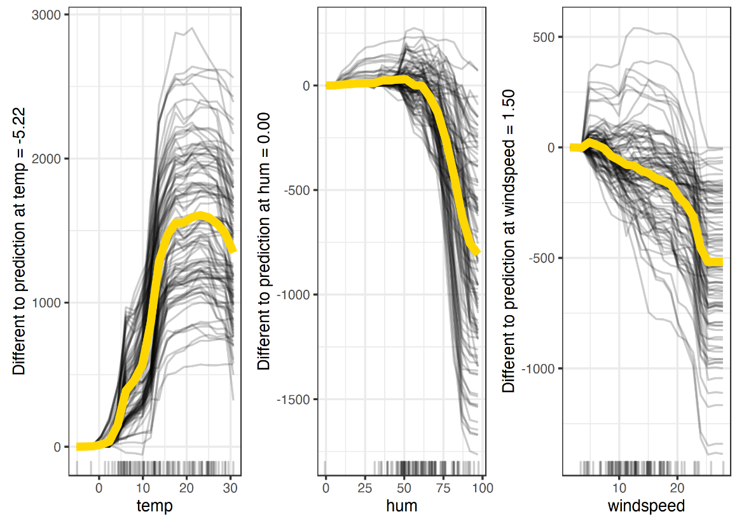
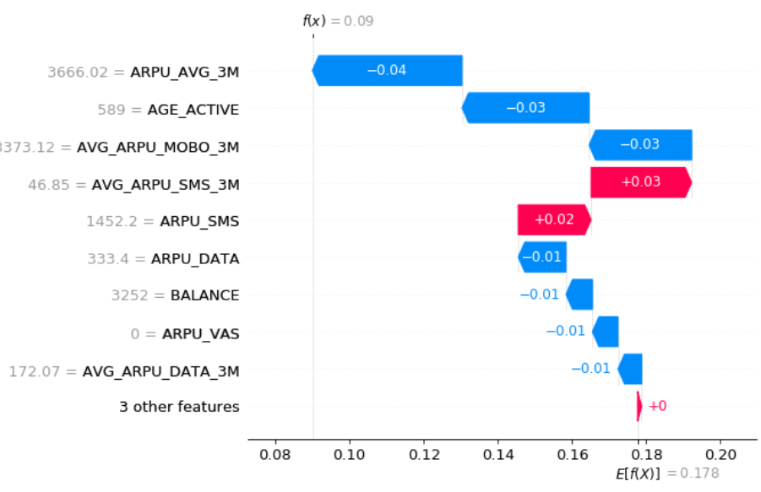
Transparency Product– Record / Prediction Explainability
Step3 – Local Explainability on specific data sample.
e prediction is lower by 2 compared to the average prediction.
Common questions to be answered:
Why was this record classified as 0/1?
Why was this record classified incorrectly?
What are the top reasons for assigning a higher(or lower) score for the record?
Why is feature X asserting a positive force on the prediction even though the univariate relationship suggests negative force?
Why is record X ranked higher than record Y?
What features does customer / record X need to improve in order to improve their score by Y points?
What is the sensitivity of feature X around this record (change in score given an x% change in feature value)?
1. Aggregated local instance effect
Individual Conditional Expectation (ICE) : display one line per instance that shows how the instance’s prediction changes when a feature changes.
Shap effect on each instance:
2. local instance explanation- Shap

Slide 8
Transparency Product– Record / Prediction Explainability
Global Explainability
Local Explainability
Predict Model + Model data
Predict Model + Model data
Which variables is important?
Yes: Permutation feature importance > 0
What are the top reasons for assigning a higher (or lower) score for this record?
No: Permutation feature importance = 0
Important Variables
Not Important Variables
Shap Value
Is this important variables correlated with other variables?
How this record compare to the whole sample
Yes: variables cluster show a correlation> 0.5
No: variables cluster show a correlation<= 0.5
High Correlated Variables
Independent Variables
Shap effect on each instance
Is this correlation contributing to final prediction?
No: H-statistic <=30%
How single variables contribute to the final prediction
What features does customer / record X need to improve in order to improve their score by Y points
Yes: H-statistic >30%
How this interaction contribute to the final prediction
ALE plot
counterfactual explanation
Does all sample behave consistently across the whole sample?
2D PDP plots
Individual Conditional Expectation (ICE)
Notes:
Process vs Product
Interpretability for Analytics Teams vs Business/Product Lead vs End Users vs CXO
Stages of development
Questions
Feature:
Relative Importance(Table); Direction(Feature vs Target Rate Line Chart)
Feature Interaction: Why 2 correlated features are present in model
Model
??
Prediction

